Slide 1

How To Prevent Data Errors
November, 2023

Slide 2

Spelling/typos/extra characters
Data Validation Rules
Spelling Checker
Proof-Read
Drop down menus

Slide 3
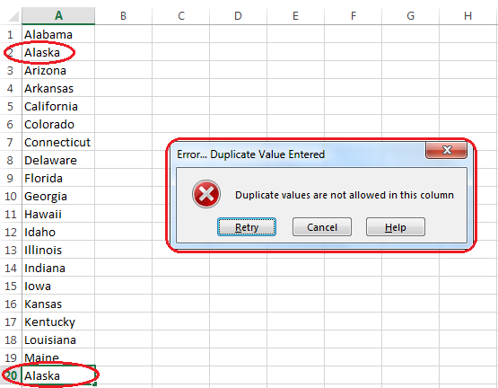
Duplicates
Unique Identifiers (Primary Key) - Databases
Clean and maintain the datasets manually
Conditional Formatting - “Remove Duplicates” – Excel
Hash algorithms

Slide 4

Incomplete Data
Regular Audits
Data Validation Rules

Slide 5

Inaccurate Data
Training Programs
Data Quality Checks

Slide 6

Data Entry Format Errors
Standardized Data Entry Forms
Input Masks

Slide 7

Data Consistency Errors
Centralized Data Governance
Integration of Data Sources

